Slide 1
Module 4

Slide 2
Module 4
Multiplexing- Space Division MultiplexingFrequency Division Multiplexing: Wave length Division Multiplexing - Time Division multiplexing: Characteristics, Digital Carrier system, SONET/SDH-Statistical time division multiplexing: Cable Modem - Code Division Multiplexing. Multiple Access– CDMA

Slide 3
MULTIPLEXING
Whenever the bandwidth of a medium linking two devices is greater than the bandwidth needs of the devices, the link can be shared.
Multiplexing is the set of techniques that allows the simultaneous transmission of multiple signals across a single data link.
As data and telecommunications use increases, so does traffic. We can accommodate this increase by continuing to add individual links each time a new channel is needed; or we can install higher-bandwidth links and use each to carry multiple signals.

Slide 4
Advantages
Advantages are
1: it reduces number of wires.
2:it reduces circuit complexity and cost.
3:it simplifies logic design.

Slide 5
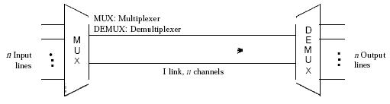
Dividing a link into channels

Slide 6
multiplexed system
In a multiplexed system, n lines share the bandwidth of one link.
The lines on the left direct their transmission streams to a multiplexer (MUX), which combines them into a single stream (many-to one).
At the receiving end, that stream is fed into a demultiplexer (DEMUX), which separates the stream back into its component transmissions (one-to-many) and directs them to their corresponding lines.

Slide 7
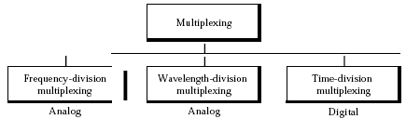
Categories of multiplexing

Slide 8
Frequency-Division Multiplexing
Frequency-division multiplexing (FDM) is an analog technique that can be applied when the bandwidth of a link (in hertz) is greater than the combined bandwidths of the signals to be transmitted.
In FDM, signals generated by each sending device modulate different carrier frequencies.
These modulated signals are then combined into a single composite signal that can be transported by the link.
Carrier frequencies are separated by sufficient bandwidth to accommodate the modulated signal.
Channels can be separated by strips of unused bandwidth-guard bands-to prevent signals from overlapping. In addition, carrier frequencies must not interfere with the original data frequencies.

Slide 9
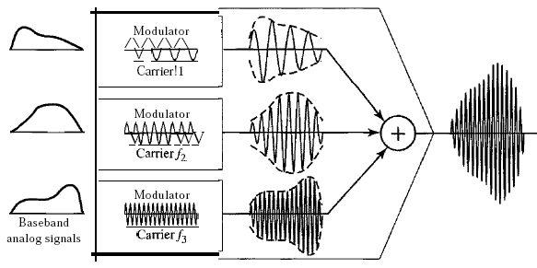
FDM is an analog multiplexing technique that combines analog signals.

Slide 10
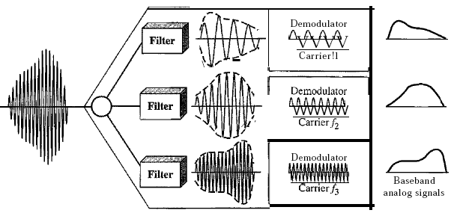
FDM demultiplexing

Slide 11
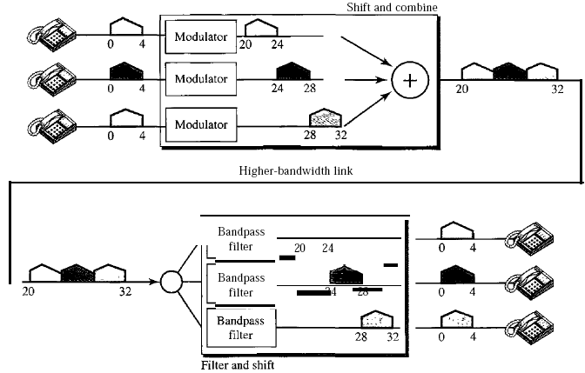
Assume that a voice channel occupies a bandwidth of 4 kHz. We need to combine three voice channels into a link with a bandwidth of 12 kHz, from 20 to 32 kHz. Show the configuration, using the frequency domain.

Slide 12
Applications of FDM
AM and FM radio broadcasting.
television broadcasting.
first generation of cellular telephones

Slide 13
Wavelength-Division Multiplexing
Wavelength-division multiplexing (WDM) is designed to use the high-data-rate capability of fiber-optic cable.
The optical fiber data rate is higher than the data rate of metallic transmission cable.
Using a fiber-optic cable for one single line wastes the available bandwidth.
Multiplexing allows us to combine several lines into one.
WDM is conceptually the same as FDM, except that the multiplexing and demultiplexing involve optical signals transmitted through fiber-optic channels.
The idea is the same:
We are combining different signals of different frequencies.
The difference is that the frequencies are very high.

Slide 14
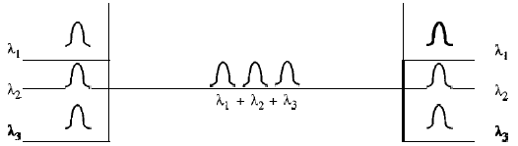
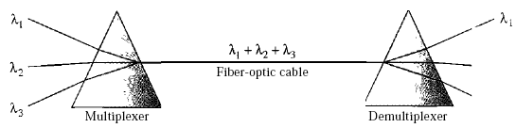
Wavelength-division multiplexing
WDM is an analog multiplexing technique to combine optical signals.
The combining and splitting of light sources are easily handled by a prism.

Slide 15
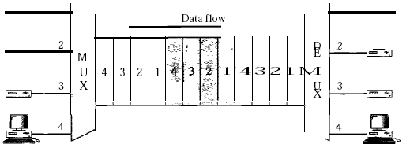
Synchronous Time-Division Multiplexing
Time-division multiplexing (TDM) is a digital process that allows several connections to share the high bandwidth of a line
Instead of sharing a portion of the bandwidth as in FDM, time is shared.
Each connection occupies a portion of time in the link.

Slide 16
Time-Division Multiplexing
TDM , in principle, a digital multiplexing technique.
Digital data from different sources are combined into one timeshared link.
However, this does not mean that the sources cannot produce analog data;
analog data can be sampled, changed to digital data, and then multiplexed by using TDM

Slide 17
Time-Division Multiplexing
We are concerned with only multiplexing, not switching.
This means that all the data in a message from source 1 always go to one specific destination, be it 1, 2, 3, or 4.
The delivery is fixed and unvarying, unlike switching.
TDM, in principle, a digital multiplexing technique.
Digital data from different sources are combined into one timeshared link.
However, this does not mean that the sources cannot produce analog data; analog data can be sampled, changed to digital data, and then multiplexed by using TDM.

Slide 18
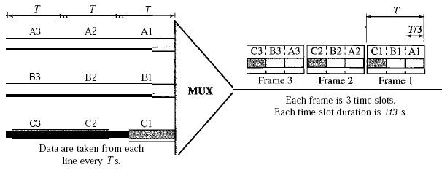
Synchronous time-division multiplexing

Slide 19
Time Slots and Frames
In synchronous TDM, the data flow of each input connection is divided into units, where each input occupies one input time slot.
A unit can be 1 bit,one character, or one block of data.
In synchronous TDM, a round of data units from each input connection is collected into a frame
If we have n connections, a frame is divided into n time slots and one slot is allocated for each unit, one for each input line.
In synchronous TDM, the data rate of the link is n times faster, and the unit duration is n times shorter.

Slide 20
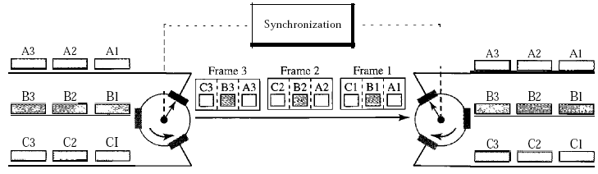
Interleaving

Slide 21
Interleaving
TDM can be visualized as two fast-rotating switches, one on the multiplexing side and the other on the demultiplexing side.
The switches are synchronized and rotate at the same speed, but in opposite directions.
On the multiplexing side, as the switch opens in front of a connection, that connection has the opportunity to send a unit onto the path.
This process is called interleaving.
On the demultiplexing side, as the switch opens in front of a connection, that connection has the opportunity to receive a unit from the path.

Slide 22
Statistical Time-Division Multiplexing
In synchronous TDM, each input has a reserved slot in the output frame.
This can be inefficient if some input lines have no data to send. In statistical time-division multiplexing, slots are dynamically allocated to improve bandwidth efficiency.
Only when an input line has a slot's worth of data to send is it given a slot in the output frame.
In statistical multiplexing, the number of slots in each frame is less than the number of input lines.
The multiplexer checks each input line in roundrobin fashion; it allocates a slot for an input line if the line has data to send; otherwise, it skips the line and checks the next line.
no slot is left empty as long as there are data to be sent by any input line.

Slide 23
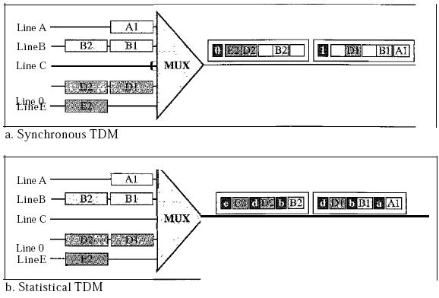
TDM slot comparison

Slide 24
Statistical TDM Addressing
An output slot in synchronous TDM is totally occupied by data; in statistical TDM, a slot needs to carry data as well as the address of the destination.
In synchronous TDM, there is no need for addressing; synchronization and preassigned relationships between the inputs and outputs serve as an address.
In statistical multiplexing, there is no fixed relationship between the inputs and outputs because there are no preassigned or reserved slots.
We need to include the address of the receiver inside each slot to show where it is to be delivered.

Slide 25
Statistical TDM Slot Size
Since a slot carries both data and an address in statistical TDM, the ratio of the data size to address size must be reasonable to make transmission efficient.
For example, it would be inefficient to send 1 bit per slot as data when the address is 3 bits.
This would mean an overhead of 300 percent. In statistical TDM, a block of data is usually many bytes while the address is just a few bytes.
Statistical TDM “No Synchronization Bit”
There is another difference between synchronous and statistical TDM, but this time it is at the frame level.
The frames in statistical TDM need not be synchronized, so we do not need synchronization bits.

Slide 26
Statistical TDM “Bandwidth”
In statistical TDM, the capacity of the link is normally less than the sum of the capacities of each channel.
The designers of statistical TDM define the capacity of the link based on the statistics of the load for each channel.
If on average only x percent of the input slots are filled, the capacity of the link reflects this.
Of course, during peak times, some slots need to wait.

Slide 27
Code-Division Multiple Access (CDMA)
Code-division multiple access (CDMA) was conceived several decades ago.
Recent advances in electronic technology have finally made its implementation possible.
CDMA differs from FDMA because only one channel occupies the entire bandwidth of the link.
It differs from TDMA because all stations can send data simultaneously; there is no timesharing.
In CDMA, one channel carries all transmissions simultaneously.

Slide 28
Analogy
Let us first give an analogy.
CDMA simply means communication with different codes.
For example, in a large room with many people, two people can talk in English if nobody else understands English.
Another two people can talk in Chinese if they are the only ones who understand Chinese, and so on.
In other words, the common channel, the space of the room in this case, can easily allow communication between several couples, but in different languages (codes).

Slide 29
CDMA idea!!
Let us assume we have four stations 1, 2, 3, and 4 connected to the same channel.
The data from station 1 are d1 , from station 2 are d2, and so on.
The code assigned to the first station is c1, to the second is c2, and so on.
We assume that the assigned codes have two properties.
1. If we multiply each code by another, we get 0.
2. If we multiply each code by itself, we get 4 (the number of stations).
With these two properties, the above four stations can send data using the same common channel,

Slide 30
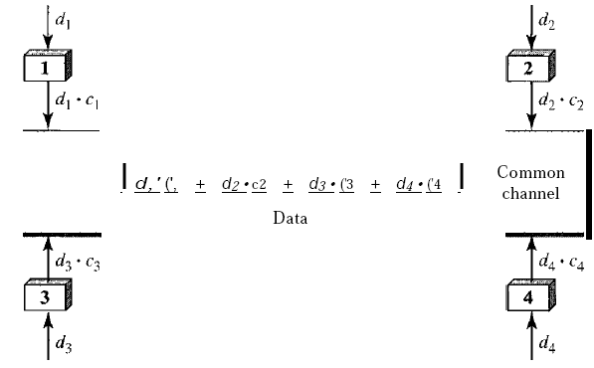
Simple idea of communication with code

Slide 31
Simple idea of communication with code
Station 1 multiplies its data by its code to get d1*c1
Station 2 multiplies its data by its code to get d2*c2…And so on.
The data that go on the channel are the sum of all these terms, as shown in the box.
Any station that wants to receive data from one of the other three multiplies the data on the channel by the code of the sender.

Slide 32
Simple idea of communication with code
For example, suppose stations 1 and 2 are talking to each other. Station 2 wants to hear what station I is saying.
It multiplies the data on the channel by cl' the code of station 1.
Because (c1 . c1) is 4, but (c2 . c1), (c3 . c1), and (c4 . c1) are all 0s
Station 2 divides the result by 4 to get the data from station 1.
data = (d*c1 + d2*c3 +d3*c3 + d4*c4)*c1
= d1*c1*c1+ d2*c2*c1 + d3*c3*c1+ d4*c4*c1
= 4 * d1

Slide 33
CDMA Chips
CDMA is based on coding theory. Each station is assigned a code, which is a sequence of numbers called chips
Chip sequences
For now, we need to know that we did not choose the sequences randomly; they were carefully selected.

Slide 34
They are called orthogonal sequences and have the following properties:
1. Each sequence is made of N elements, where N is the number of stations.
2. If we multiply a sequence by a number, every element in the sequence is multiplied by that element. This is called multiplication of a sequence by a scalar. For example,
2 * [+1 +1 -1 -1] = [+2 +2 -2 -2]
3. If we multiply two equal sequences, element by element, and add the results, we get N, where N is the number of elements in the each sequence. This is called the inner product of two equal sequences. For example,
[+1 +1 -1 -1] * [+1 +1 -1 -1] = 1 + 1 + 1 + 1 = 4

Slide 35
orthogonal sequences and have the following properties:
4. If we multiply two different sequences, element by element, and add the results, we get 0. This is called inner product of two different sequences. For example,
[+1 +1 -1 -1] * [+1 +1 +1 +1] = 1 + 1 - 1 - 1 = 0
5. Adding two sequences means adding the corresponding elements. The result is another sequence. For example,
[+1 +1 -1 -1] + [+1 +1 +1 +1] = [+2 +2 0 0]

Slide 36
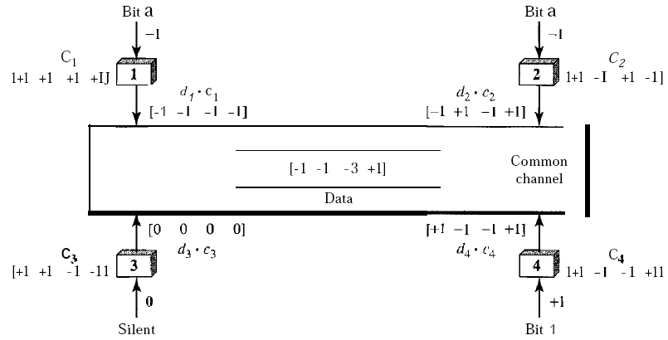
Sharing channel in CDMA

Slide 37
Encoding
We assume that stations 1 and 2 are sending a 0 bit and channel 4 is sending a 1 bit.
Station 3 is silent. The data at the sender site are translated to -1, -1, 0, and +1.
Each station multiplies the corresponding number by its chip (its orthogonal sequence), which is unique for each station.
The result is a new sequence which is sent to the channel.
The sequence on the channel is the sum of all four sequences as defined before.

Slide 38
Decoding
Now imagine station 3, which we said is silent, is listening to station 2.
Station 3 multiplies the total data on the channel by the code for station 2, which is [+1 -1 +1-1], to get
[-1-1-3 +1]* [+1-1 +1-1] = -4/4 = -1 => bit 1

Slide 39
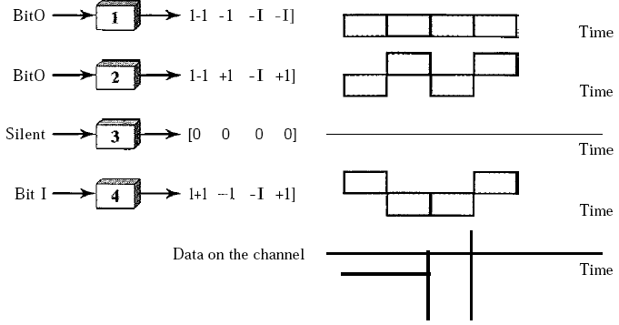
Digital signal created by four stations in CDMA

Slide 40
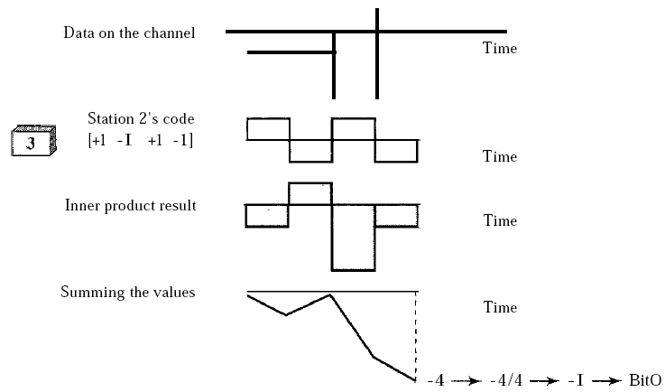
Decoding of the composite signal for one in CDMA

